Slide 1

MALLA REDDY ENGINEERING COLLEGE FOR WOMEN ( Autonomous Institution-UGC ,Govt . of India) Accredited by Innovation By NBA & NACC with’ A +’ Grade National Ranking by NIRF Innovation Rank Band(151-300).Accepted by MHRD, Govt . of India Maisammaguda,Dhulapally,Secunderabad,kompally-500100
REAL-TIME PROJECT
ON
SMART COW HEALTH MONITORING SYSTEM
Presented by:
A. SWAPNA (25RH5A0401)
B. SHREYA (25RH5A0403)
K. ITHIGNA (25RH5A0407)

Slide 2
CONTENTS
Abstract
Introduction
Method
Block diagram
implementation
Application
Conclusion

Slide 3
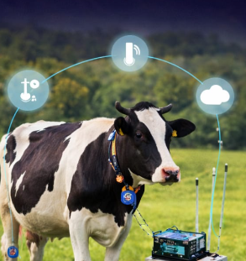
ABSTRACT
The Smart Cow Health Monitoring System is an advanced technological solution designed to improve livestock management by continuously tracking the health and well-being of cows. This system integrates wearable sensors, and data analytics to monitor vital parameters such as body temperature, heart ratein real-time.
The collected data is transmitted to a centralized platform where it is analyzed to detect early signs of diseases, stress, or abnormal behavior. enabling timely intervention and reducing the risk of severe health issues.

Slide 4
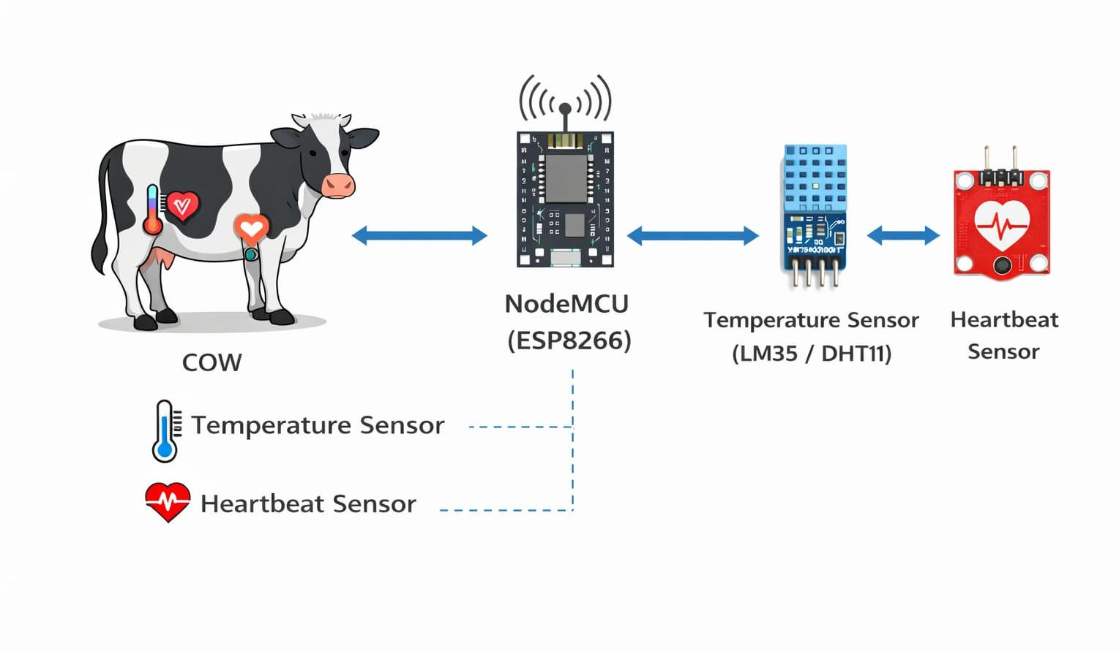
INTRODUCTION
Smart cow health monitoring system uses
modern technology to monitor cow health
Uses sensors like temperature and heart rate sensors
Collects real-time health data from the cow
Data is processed using Node MCU
Sends data to cloud for remote monitoring
Helps in early disease detection

Slide 5
METHOD
Collect health data using temperature, heart rate, and accelerometer sensors
Send sensor data to Node MCU
Process data in Node MCU using programmed logic
Compare values with predefined threshold limits
Display real-time data on OLED display

Slide 6
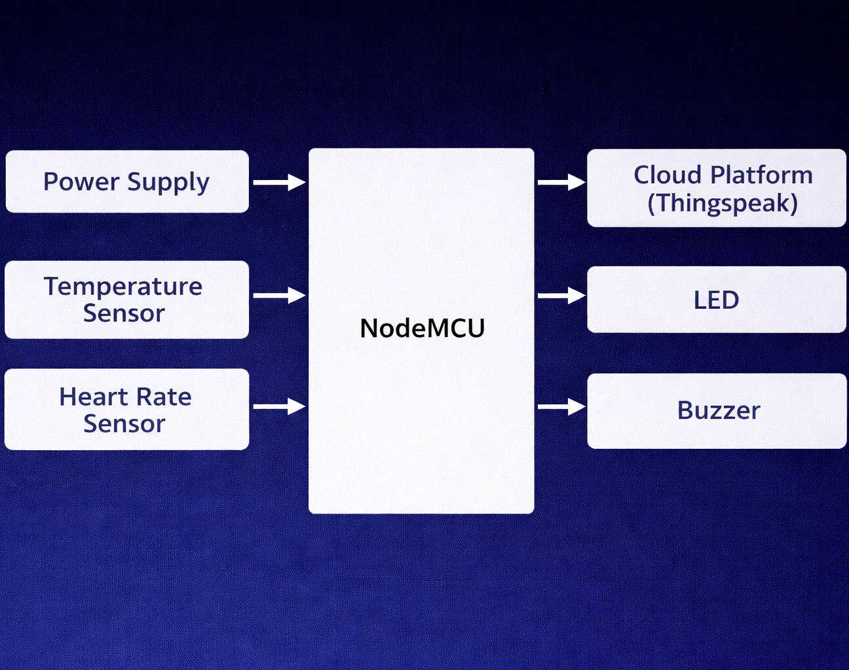
BLOCK DIAGRAM
Power supply provides energy to all components
Temperature sensor measures cow body temperature
Heart rate sensor monitors pulse rate
Accelerometer detects movement and activity of the cow
All sensor data is sent to Node MCU
Node MCU processes and analyzes the data

Slide 7
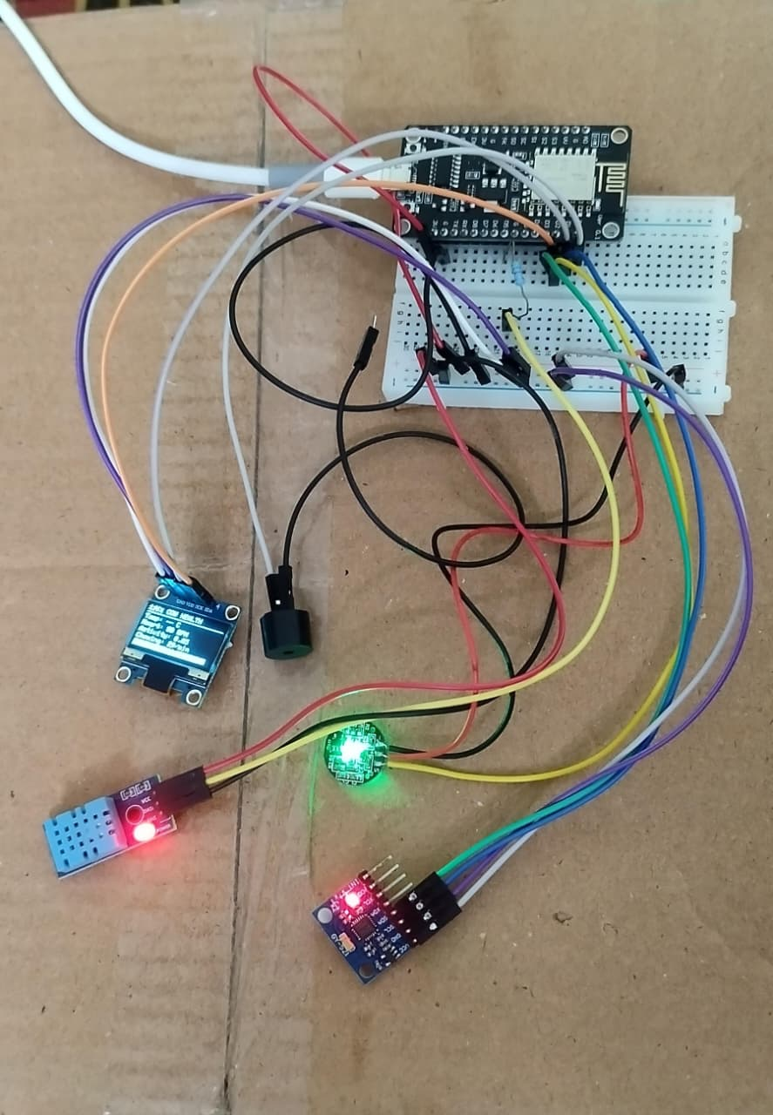
IMPLEMENTATION
Connect temperature, heart rate, and accelerometer sensors to NodeMCU
Interface OLED display and buzzer with NodeMCU
Provide power supply to all components
Write and upload code using Arduino IDE
Read and collect data from sensors
Process data and set threshold limits
Display real-time data on OLED screen

Slide 8
ADVANTAGES
Continuous health monitoring
Early disease detection
Reduces manual effort
Real-time data tracking
Remote monitoring capability
Quick alert system
Improves livestock productivity
Cost-effective solution
Easy to implement and use

Slide 9
APPLICATIONS
Livestock health monitoring
Early disease detection
Smart farming
Remote monitoring
Alert system
Veterinary support
Reduced manual work

Slide 10
CONCLUSION
The smart cow health monitoring system provides an efficient and reliable solution for continuous monitoring of livestock health. By using sensors and NodeMCU, the system collects and processes vital data and sends it to the cloud for remote access. It helps in early detection of diseases, reduces manual effort, and ensures timely alerts through buzzer and indicators. Overall, this system improves animal health management, , and supports modern smart farming practices.

Slide 11
THANK YOU

